Slide 1


GridNova Tech
Presented by-Prachi Paditkar

Slide 2
Problem Statement
GridNova Tech is a German-based company specializing in the manufacturing of electric motors, e-bikes, and charging infrastructure, has recently launched its own charging station brand. As part of their expansion strategy, they are planning to install charging stations across various cities in Germany. However, they are currently facing challenges in identifying the most suitable locations for installation.
To support their decision-making process, I have been engaged to conduct a comprehensive market analysis aimed at identifying cities with a high number of existing installations, significant daily user traffic, and full availability of essential infrastructure. Additionally, the company is seeking insights into the current landscape of charging operators in Germany, the types of charging connectors and capacities in use, and whether renewable energy sources are integrated into the charging network.

Slide 3
Objectives
Identify the most suitable German cities for installing new electric vehicle (EV) charging stations based on:
Existing number of installations
Daily user volume
Average User reviews per city
Analyze current charging station operators across Germany to understand the competitive landscape and potential partnerships or differentiators.
Examine the types of charging connectors commonly used in Germany to ensure compatibility with various EV models.
Assess the charging capacity levels being deployed and their distribution across regions.
Evaluate the presence and integration of renewable energy sources in the existing charging infrastructure.
Provide actionable, data-driven recommendations to help GridNova ChargeTech strategically deploy their charging stations for maximum impact and user accessibility.

Slide 4
Methodology
Data Cleaning & Standardization
Exploratory Data Analysis (EDA)
Visual Analytics: Charts and Graph
Insight Extraction and Recommendations

Slide 5
Market Overview of Germany Electric Vehicle Charging Station
Germany's EV charging station market is rapidly growing, fueled by strong government support, rising EV adoption, and major public and private investments. Advancements in fast-charging technology and smart energy management are also boosting demand by improving efficiency and user experience.
Germany has a total of 5,000 electric vehicle charging stations located mainly in the top German cities such as Berlin, Frankfurt, Hamburg, Köln, Leipzig, München, and Stuttgart.
According to the data, Germany saw higher installation rates of EV charging stations in the years 2013, 2015, 2017, 2020, and 2022. This trend suggests continued growth in charging infrastructure, indicating strong future opportunities for EV charging station providers.
Around 51% of the energy used for EV charging in Germany comes from renewables, highlighting the country's progress toward its 2045 carbon neutrality goal and its commitment to clean, sustainable mobility.
The charging capacity of the charger is 22 kW, 50 kW, 150 kW, 350 kW, and their maintenance frequency are annually, monthly, and quarterly. The charging station availability times are from 6:00 -22:00, 9:00 -18:00, 24/7a and it varies from location to location.
Furthermore, Germany’s electric vehicle (EV) charging station market is dominated by only five major players: EVgo, ChargePoint, Greenlots, Ionity, and Tesla.

Slide 6

Market Segmentation
By Countries
By Connector Type
Berlin
Frankfurt
Hamburg
Köln
Leipzig
München
Stuttgart
CCS, CHAdeMO
Tesla, Type 2
Type 2
CCS, Tesla
CHAdeMO, Tesla
Tesla, CCS
CHAdeMO, Type 2
Others
By Charging Capacity
Major key players
22 kW
50 kW
150 kW
350 kW
EVgo
ChargePoint
Greenlots
Ionity
Tesla
By Availability (in time)
6:00-22:00
9:00-18:00
24/7

Slide 7
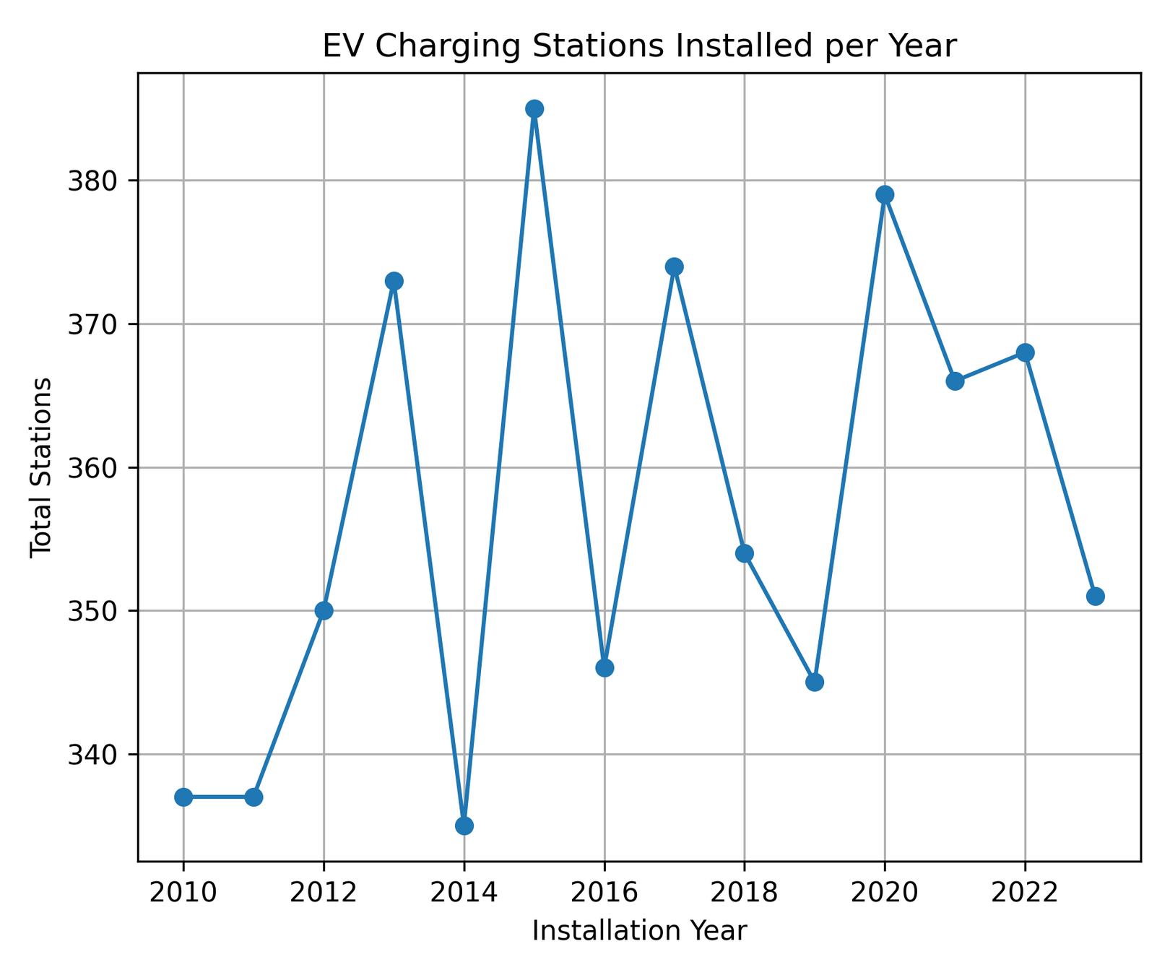
Number of EV charging station installed in Germany

Slide 8
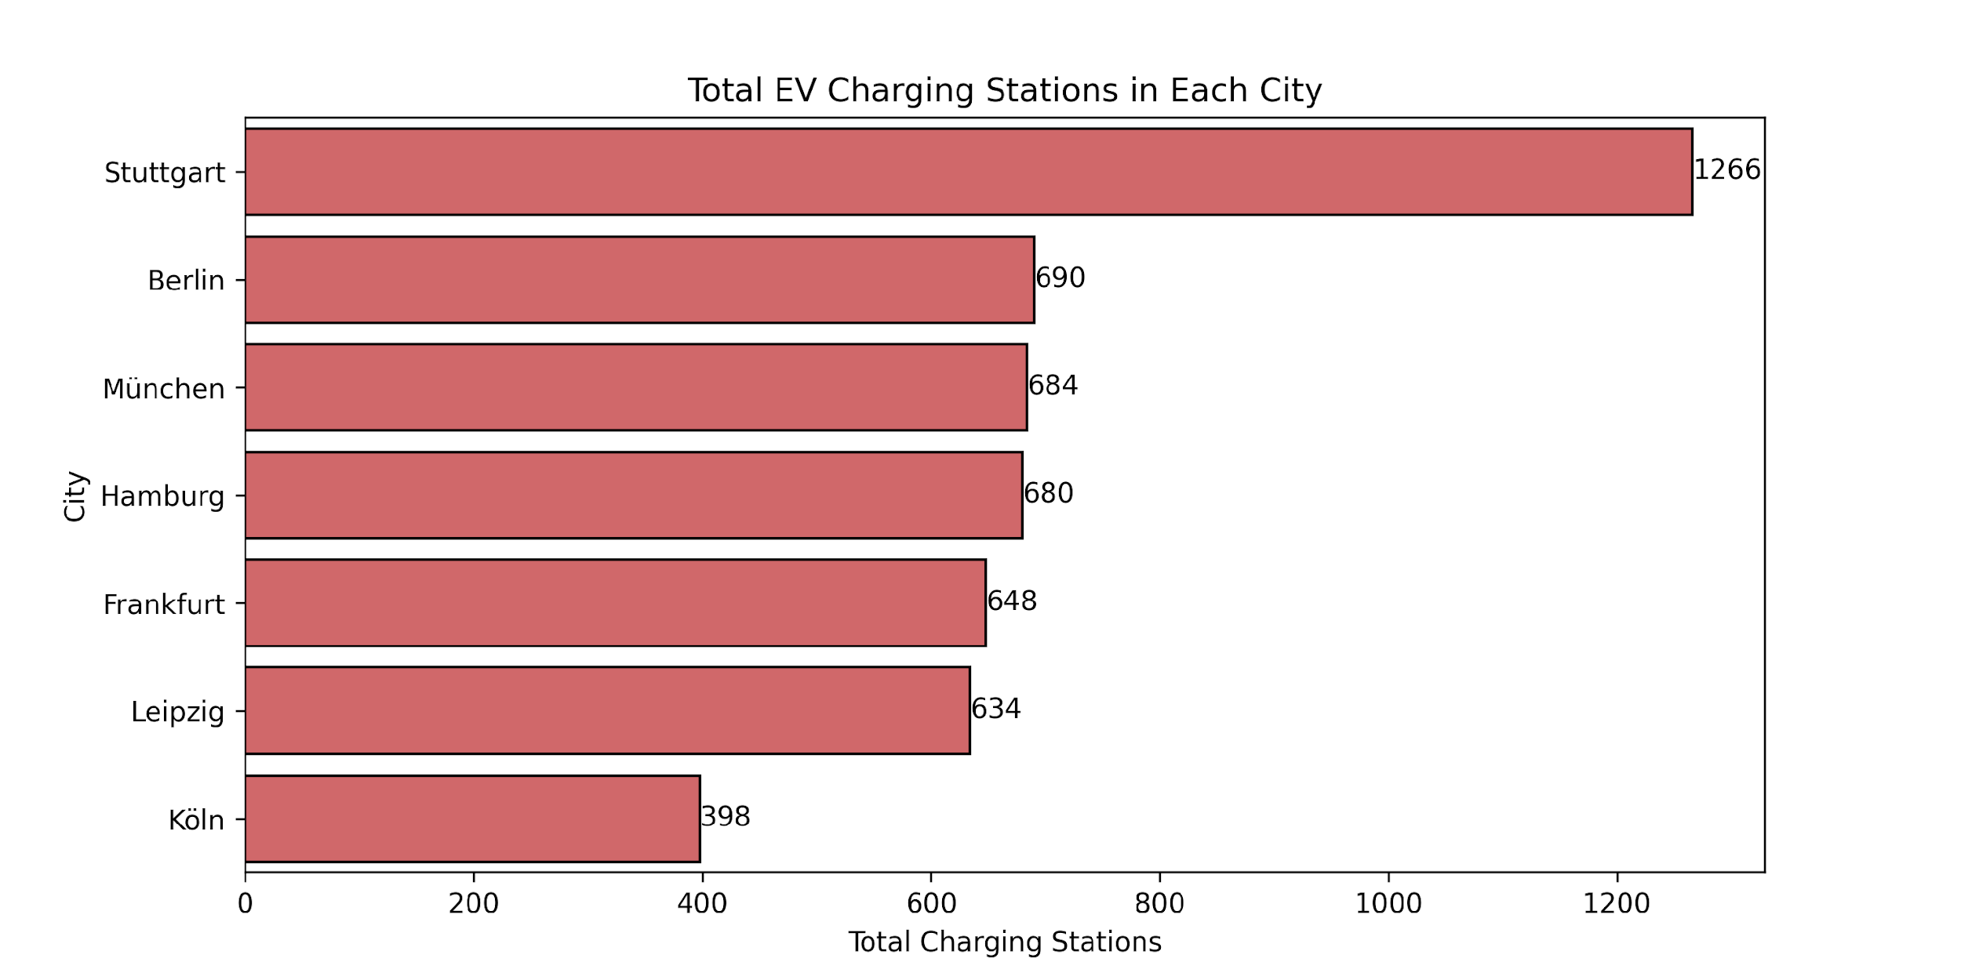
Top 7 Cities in Germany with the Highest Number of Electric Vehicle Charging Stations:

Slide 9
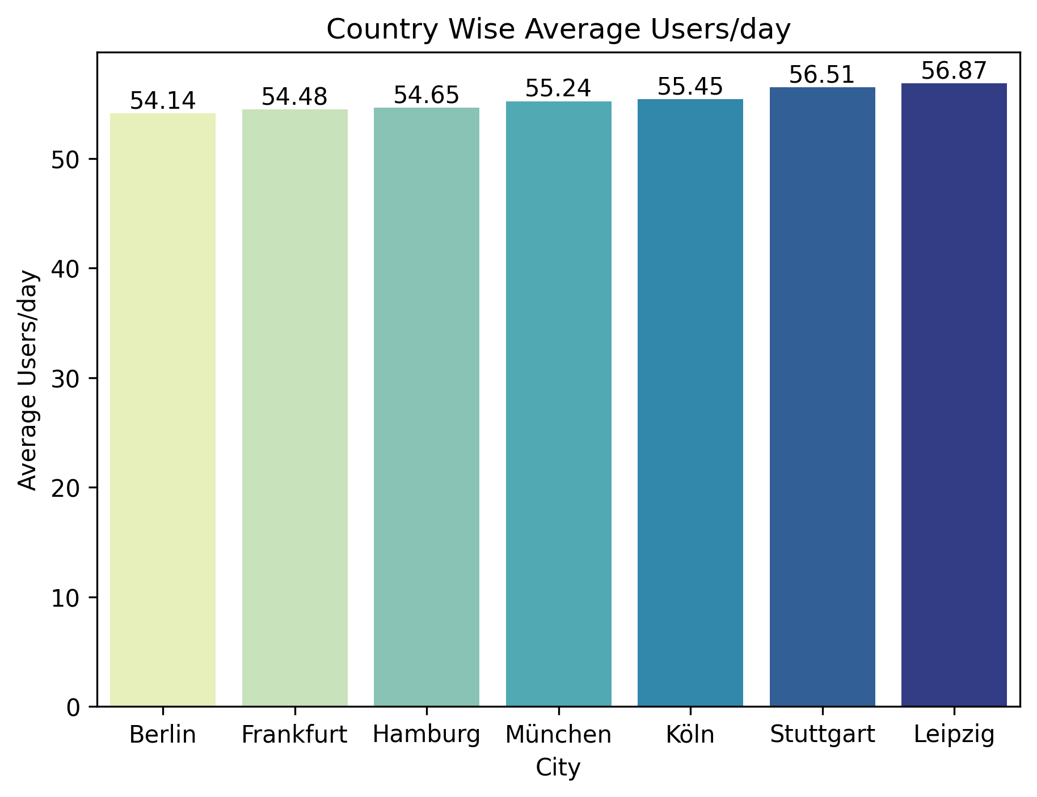
Average Daily Users of Electric Vehicle Charging Stations by City:

Slide 10
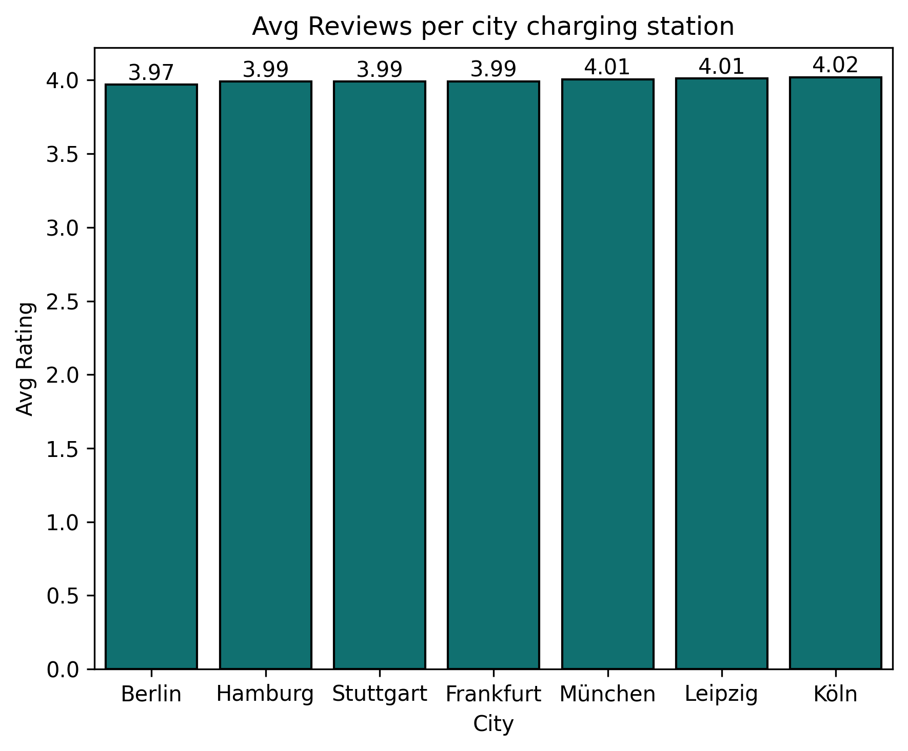
Average Rating of Electric Vehicle Charging Stations by City:

Slide 11
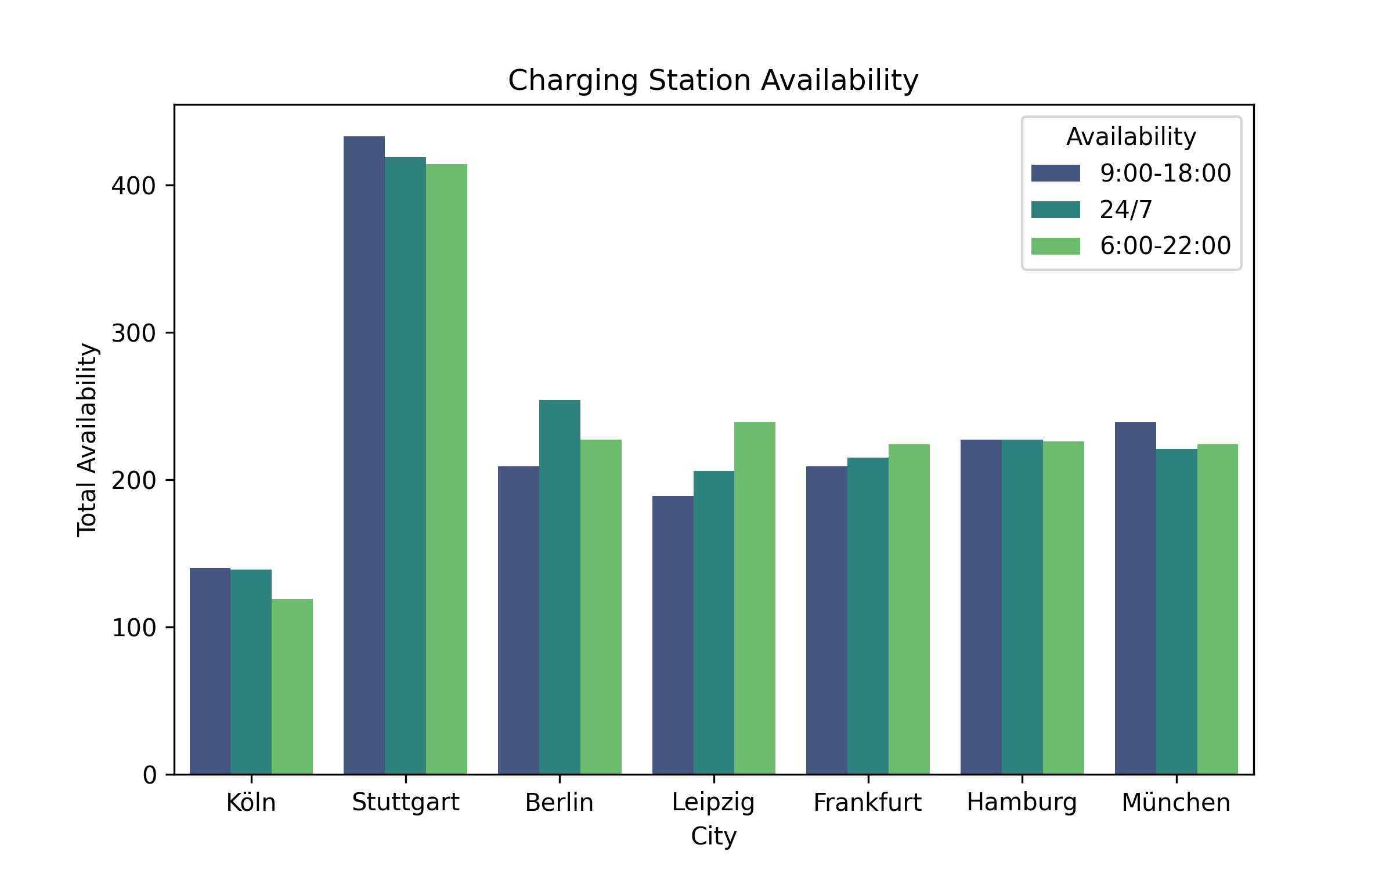
Charging Station Availability:

Slide 12
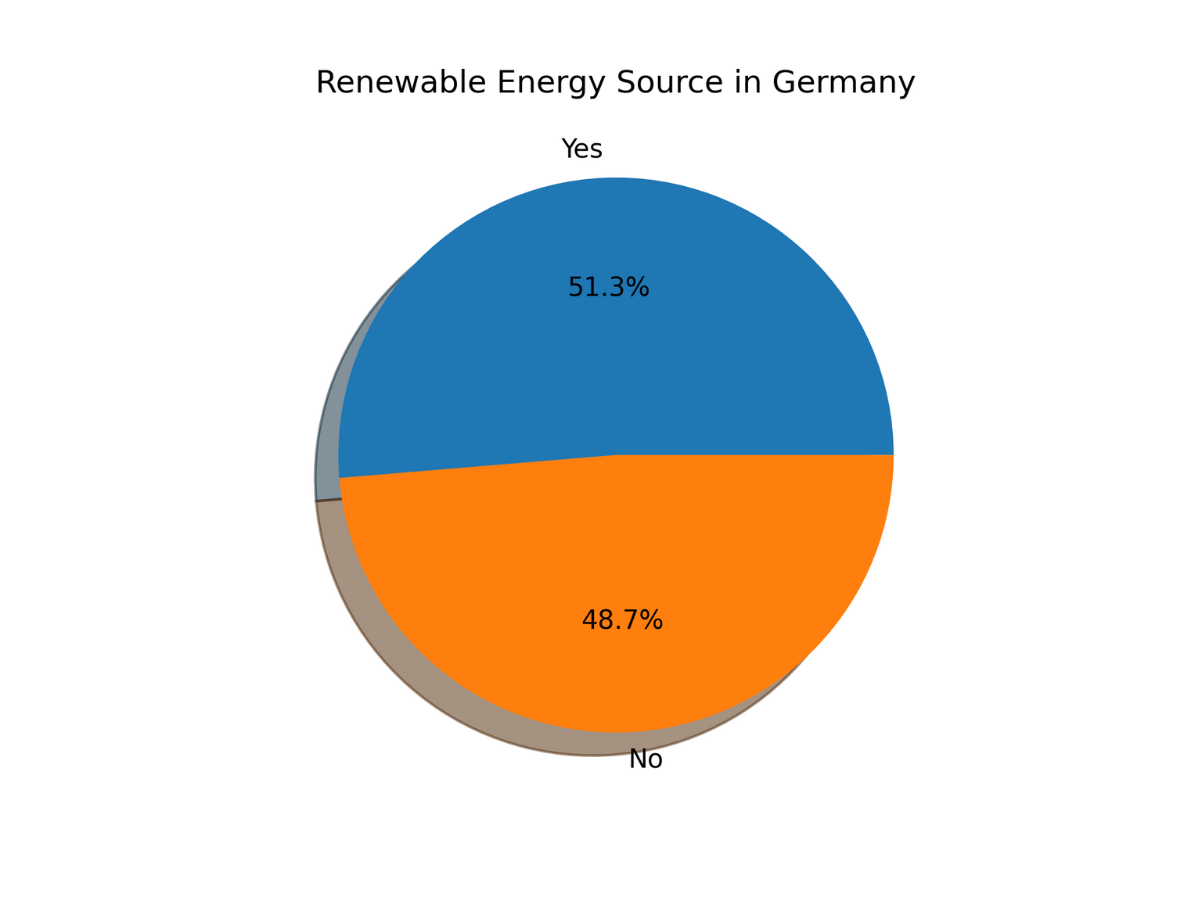
Presence of renewable source in Germany:

Slide 13
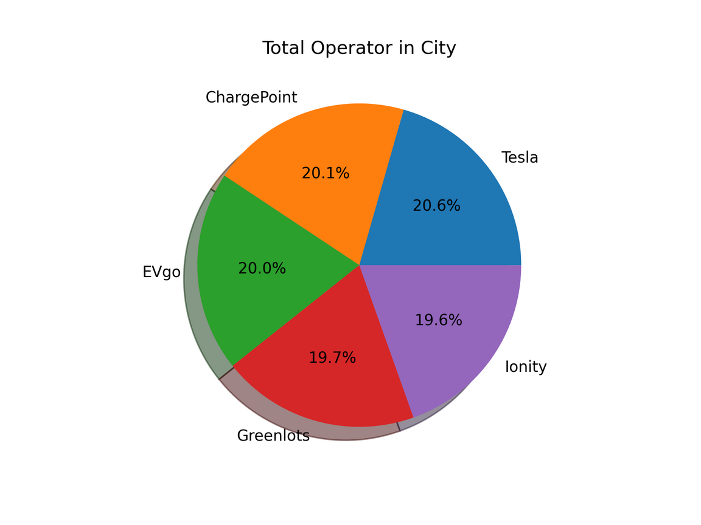
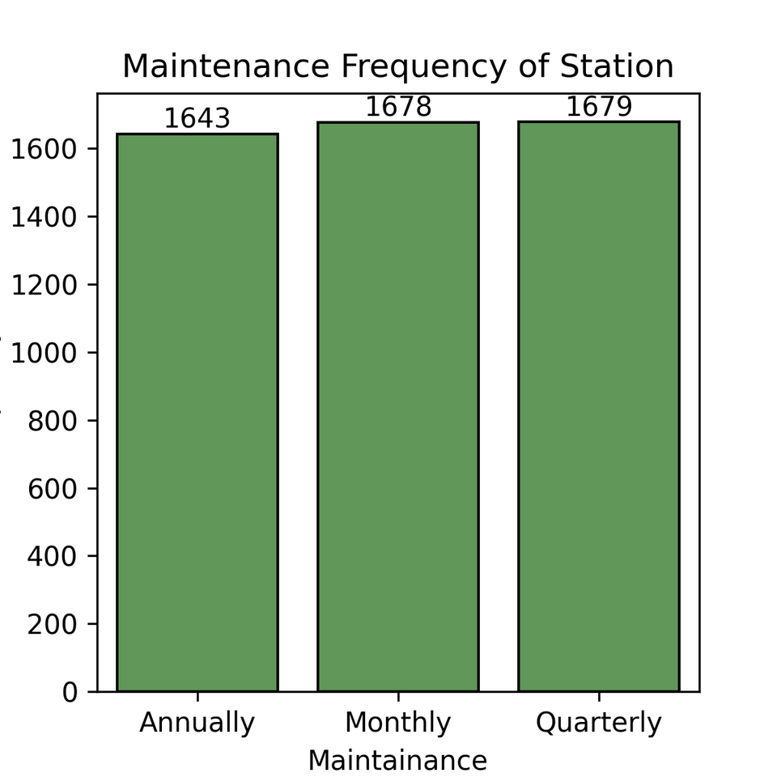
Top operators of charging stations in Germany and their market share
Maintenance Frequency of Charging Stations in Germany

Slide 14
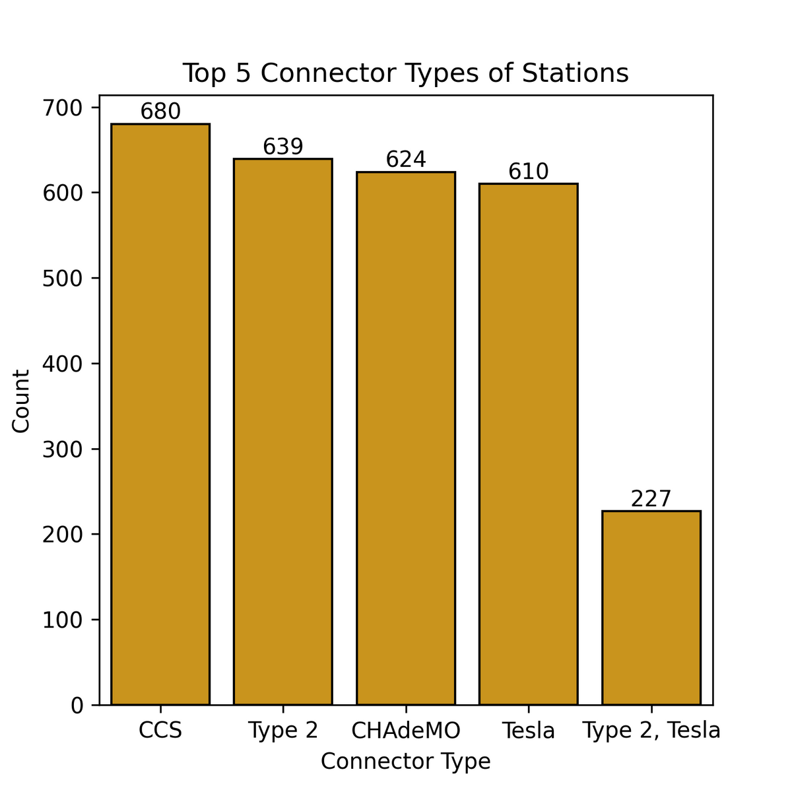
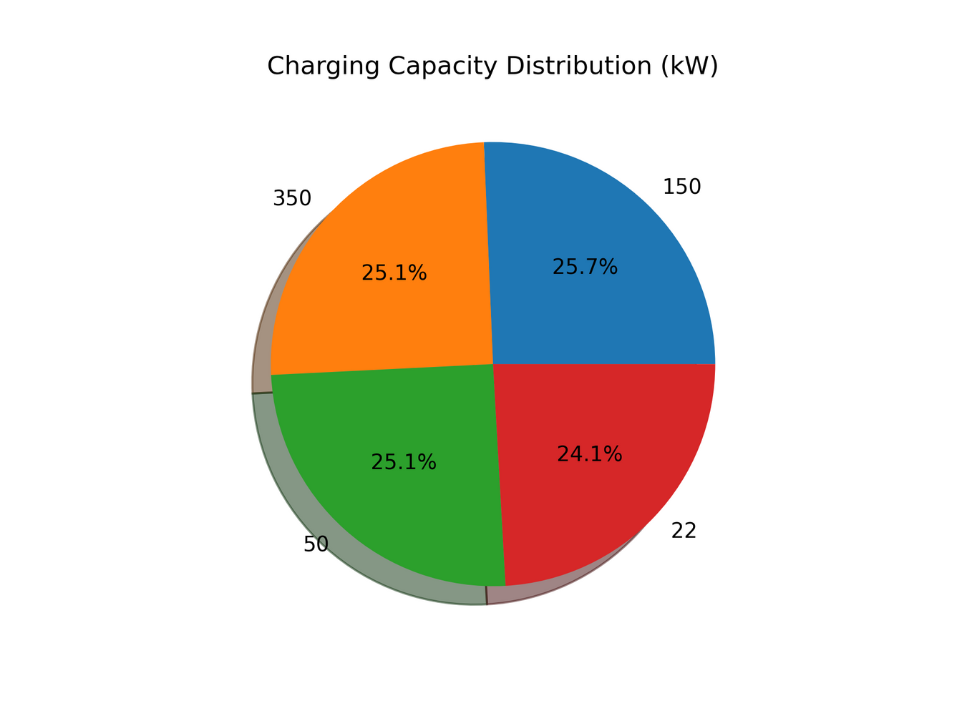
Top 5 charging connectors in Germany
Charging capacity segmentation

Slide 15

Key Findings
Top Countries:
Top 4 cities where higher number of charging stations are Stuttgart, Berlin, Hamburg, and München cities.
Top 4 cities with highest average users/day are Stuttgart, Leipzig, Köln, München.
The leading cities with ratings above 4 include Köln, Leipzig, and München.
Targting:
Top companies with 20% market share are Tesla, ChargePoint, and EVgo.
Top 5 connector types of charging stations are CCS, Type 2, CHAdeMO, Tesla, and Type 2,Tesla.
The charging capacity of the majority of EV charging stations is 50kW, 150kW, and 350kW, which accounts for nearly 25% of the market share.

Slide 16

Recommendations
GridNova Tech should proceed with the installation of EV charging stations, targeting high-demand, high-visibility cities such as
München- Among the top cities for a number of stations i.e. 684, average users/day (55.24), and high user ratings(4.01). Strong EV adoption and consistent demand.
Stuttgart- The highest number of charging stations accounts for a 25.32% share and approximately 56.51 average users per day. High EV awareness and infrastructure development.
Berlin- The city with the second highest number of charging stations contributes 13%, rating 3.97 but has considerably fewer average daily users(54.14), potentially offering growth opportunities.
Leipzig- The city with the highest daily average users is about 56.87, featuring 634 charging stations that account for 12.68% and holds a rating of 4.01.

Slide 17
Recommendations
GridNova Tech can benefit from partnerships with Tesla, ChargePoint, and EVgo through access to established networks, enhanced brand credibility, improved interoperability, shared insights, and opportunities for joint innovation in dynamic pricing and ultra-fast charging.
GridNova Tech should prioritize CCS, Type 2, and CHAdeMO connector types in station design for compatibility with EVs. Fast chargers in 50kW, 150kW, and 350kW, accounting for 25% of the market, will meet consumer expectations for efficiency and speed.
The presence of more than 50% renewable energy sources for EV charging stations can create market growth opportunities for company.

Slide 18
Thank you

